Slide 1










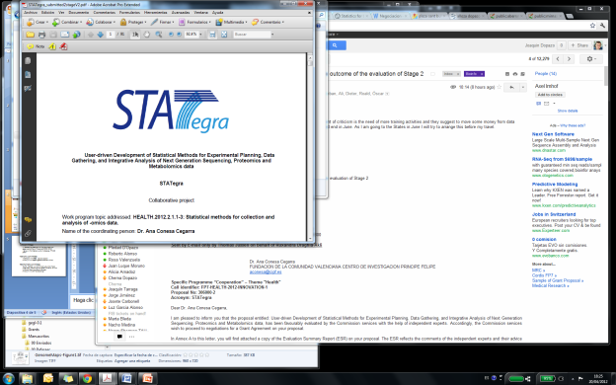





Variant prioritization
Joaquín Dopazo
Computational Genomics Department,
Centro de Investigación Príncipe Felipe (CIPF),
Functional Genomics Node, (INB),
Bioinformatics Group (CIBERER) and
Medical Genome Project,
Spain.
http://bioinfo.cipf.es
http://www.medicalgenomeproject.com
http://www.babelomics.org
http://www.hpc4g.org
@xdopazo
University of Cambridge, 23-25 February 2015

Slide 2
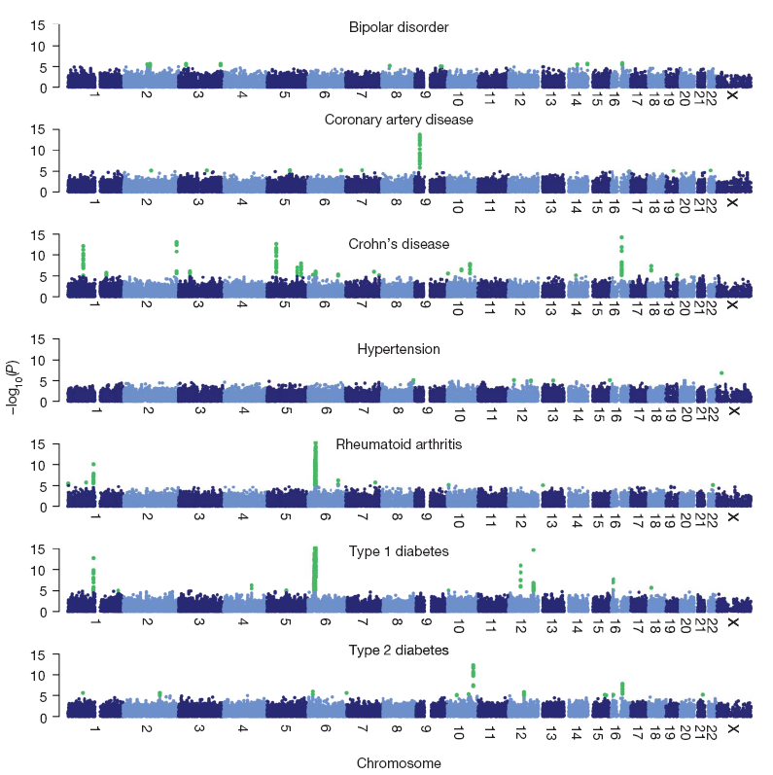
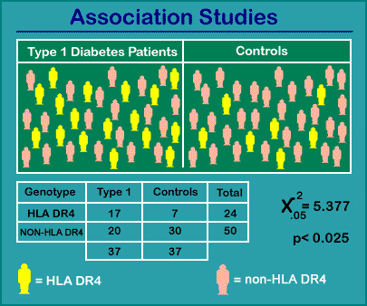

The dawn of genomic data production
Candidate gene studies using GWAS
Odds Ratio: 3.6
95% CI = 1.3 to 10.4

Slide 3
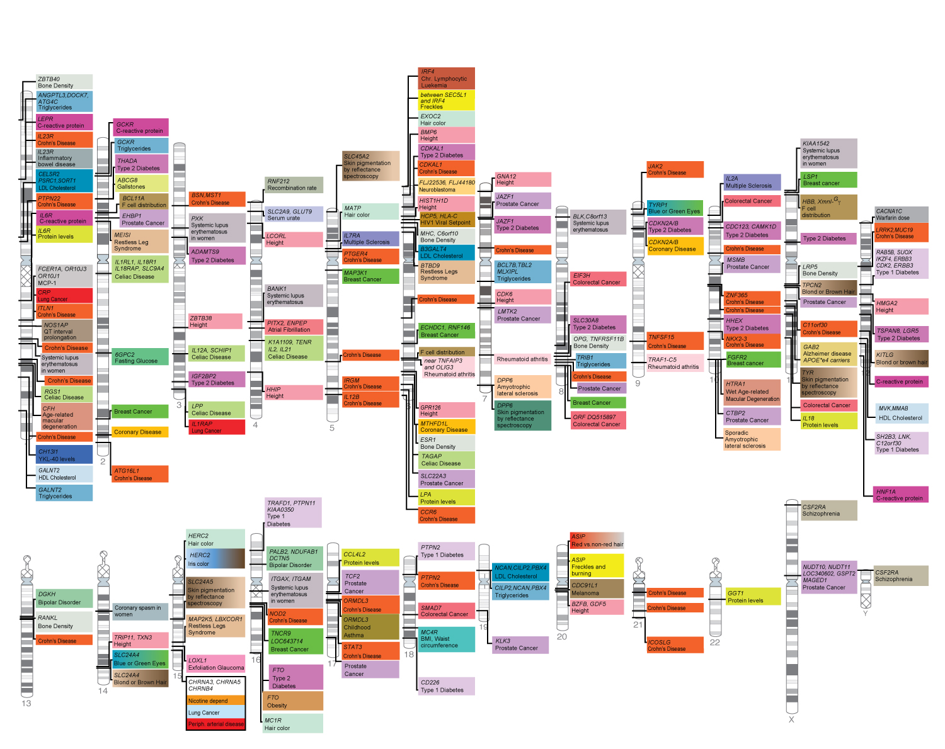
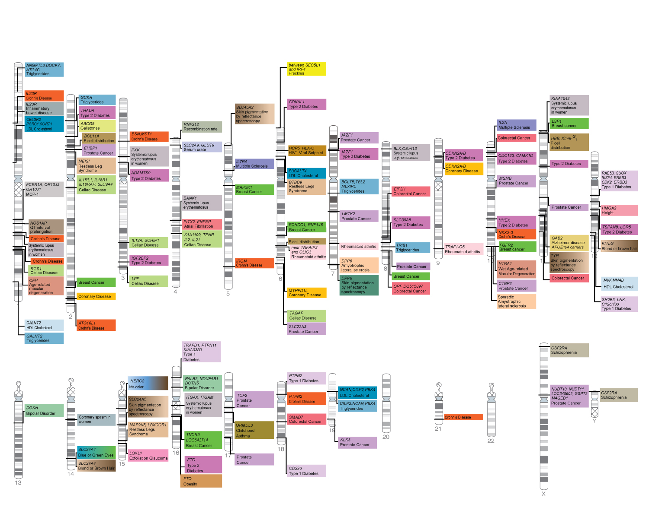
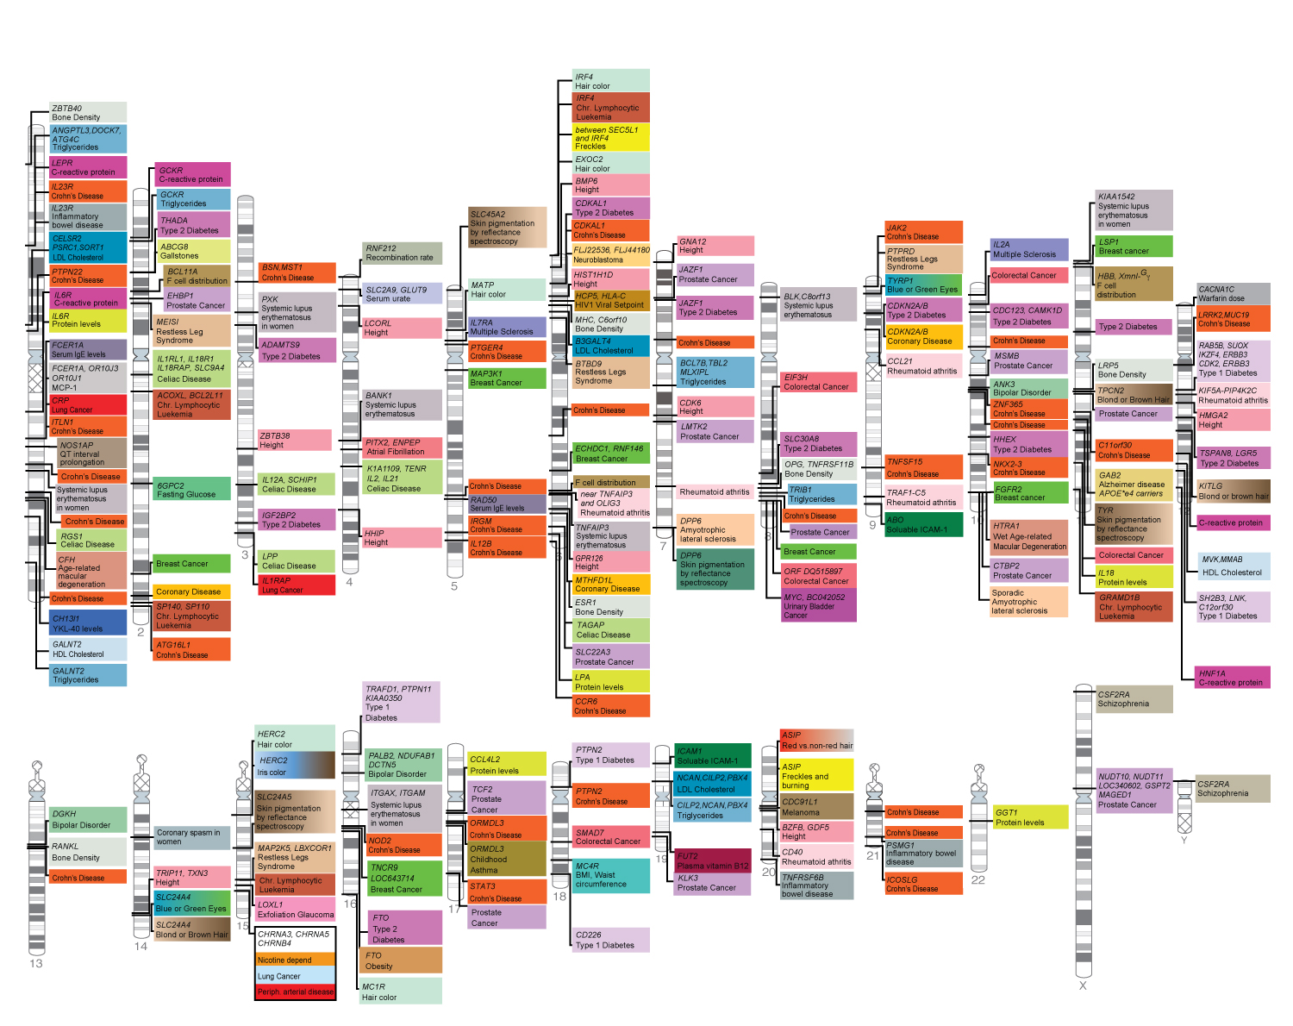
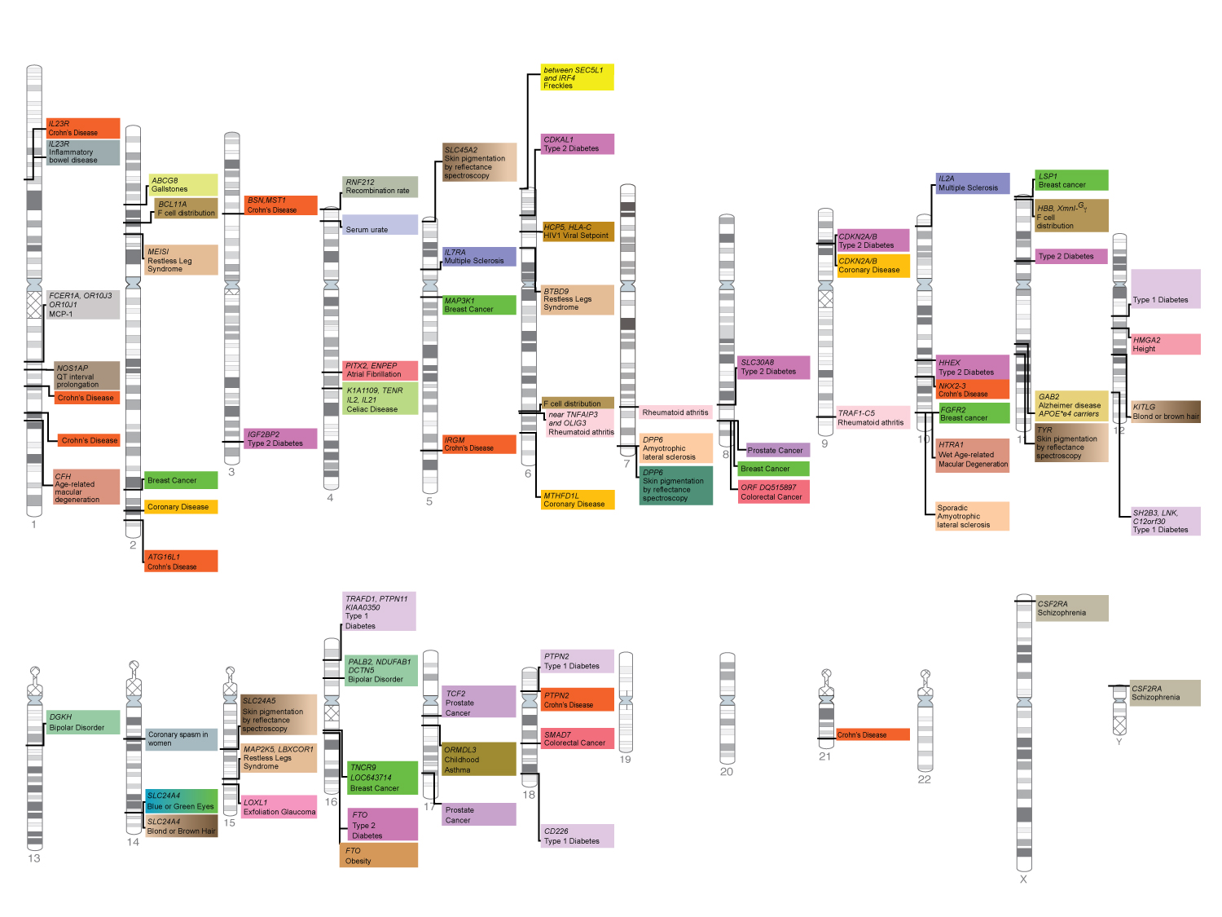
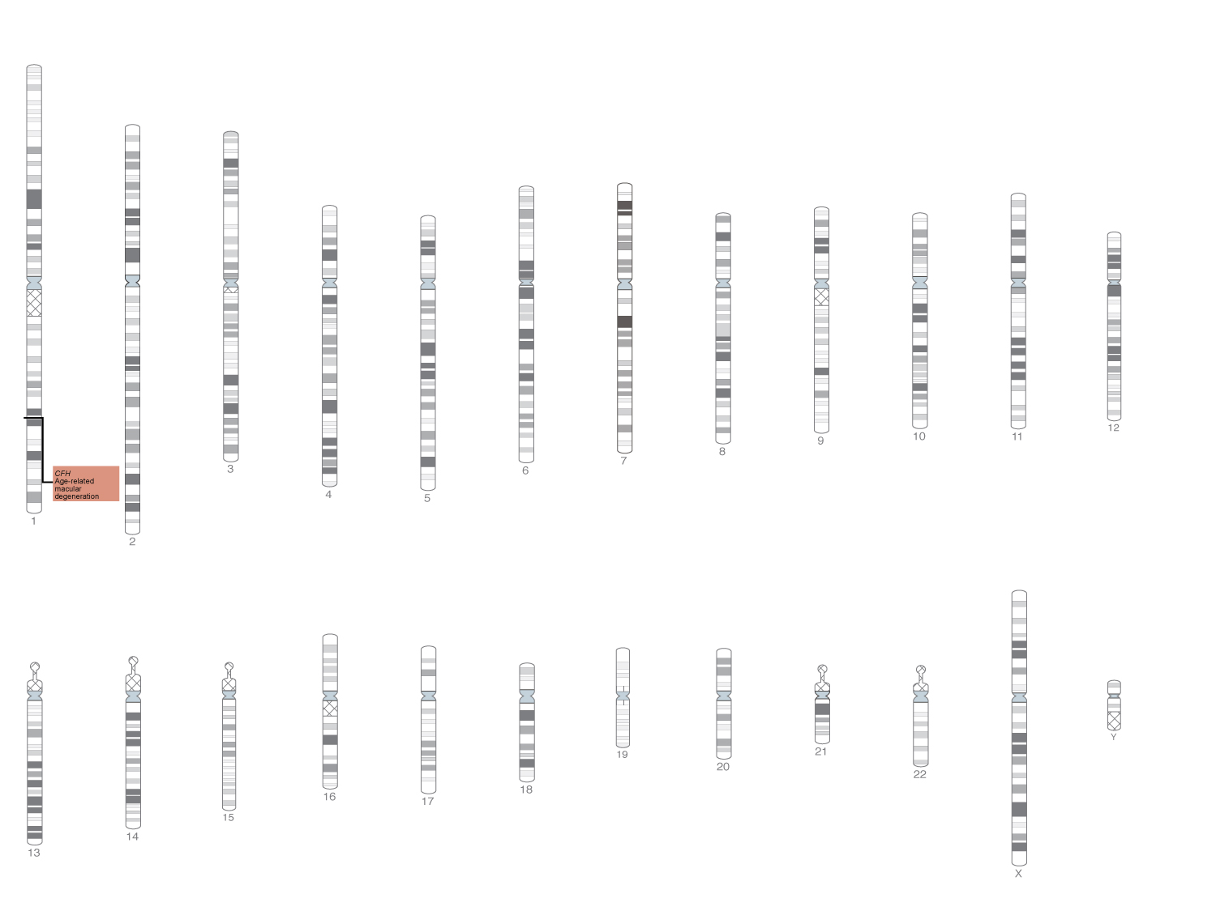
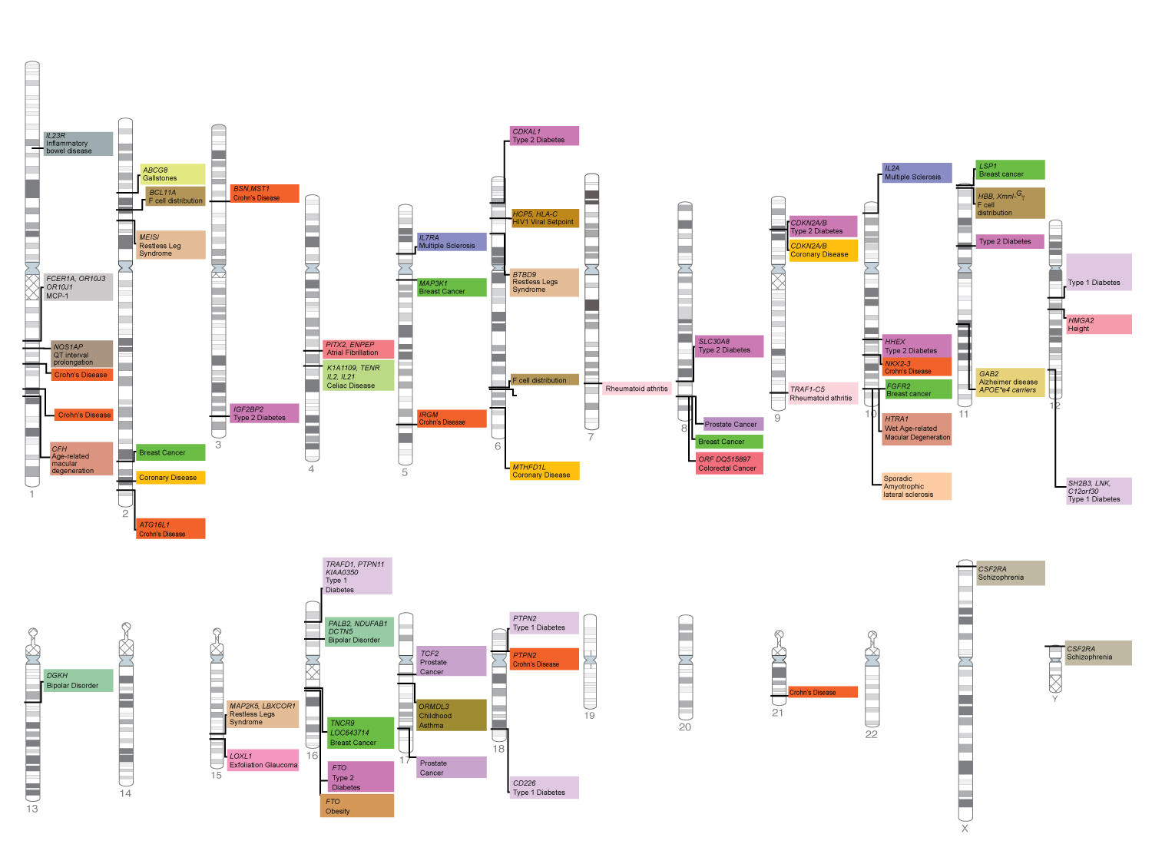
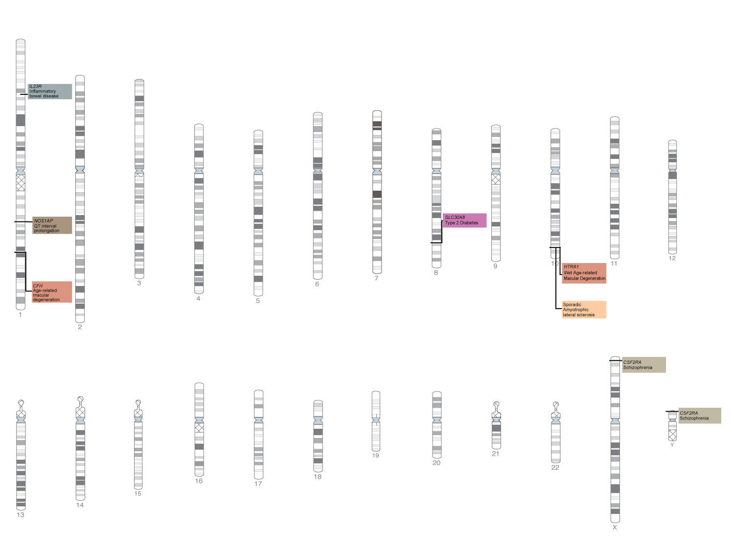
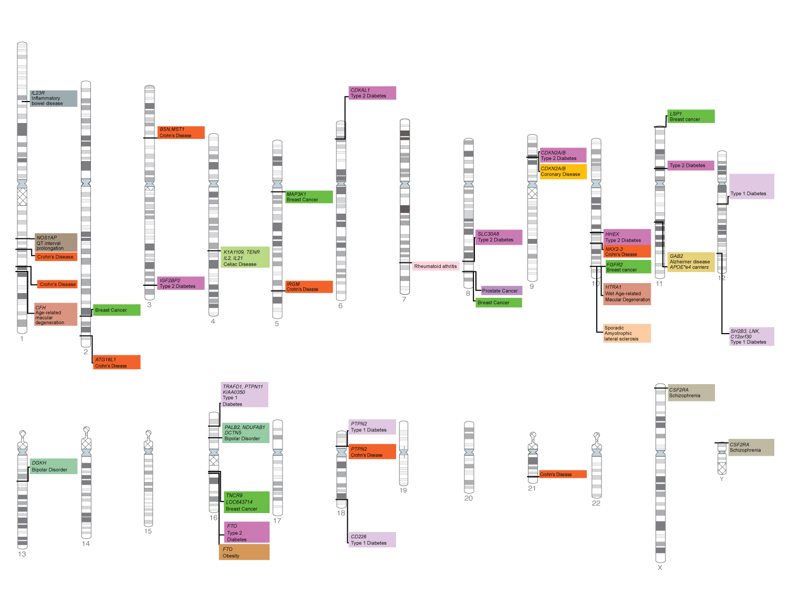
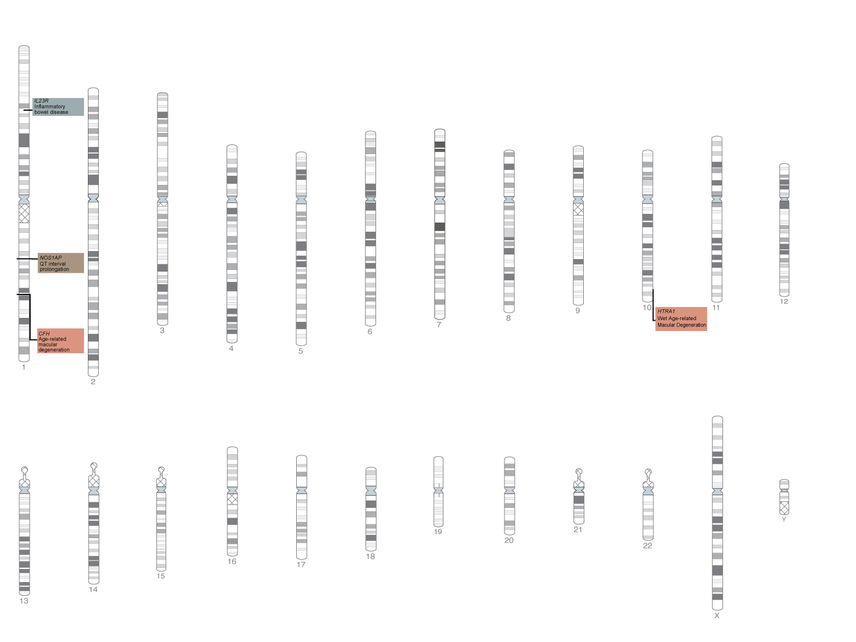
2008 first quarter
2008 second quarter
2008 third quarter
2007 third quarter
2007 second quarter
2005
2007 fourth quarter
2006
2007 first quarter
Manolio, Brooks, Collins, J. Clin. Invest., May 2008

Slide 4
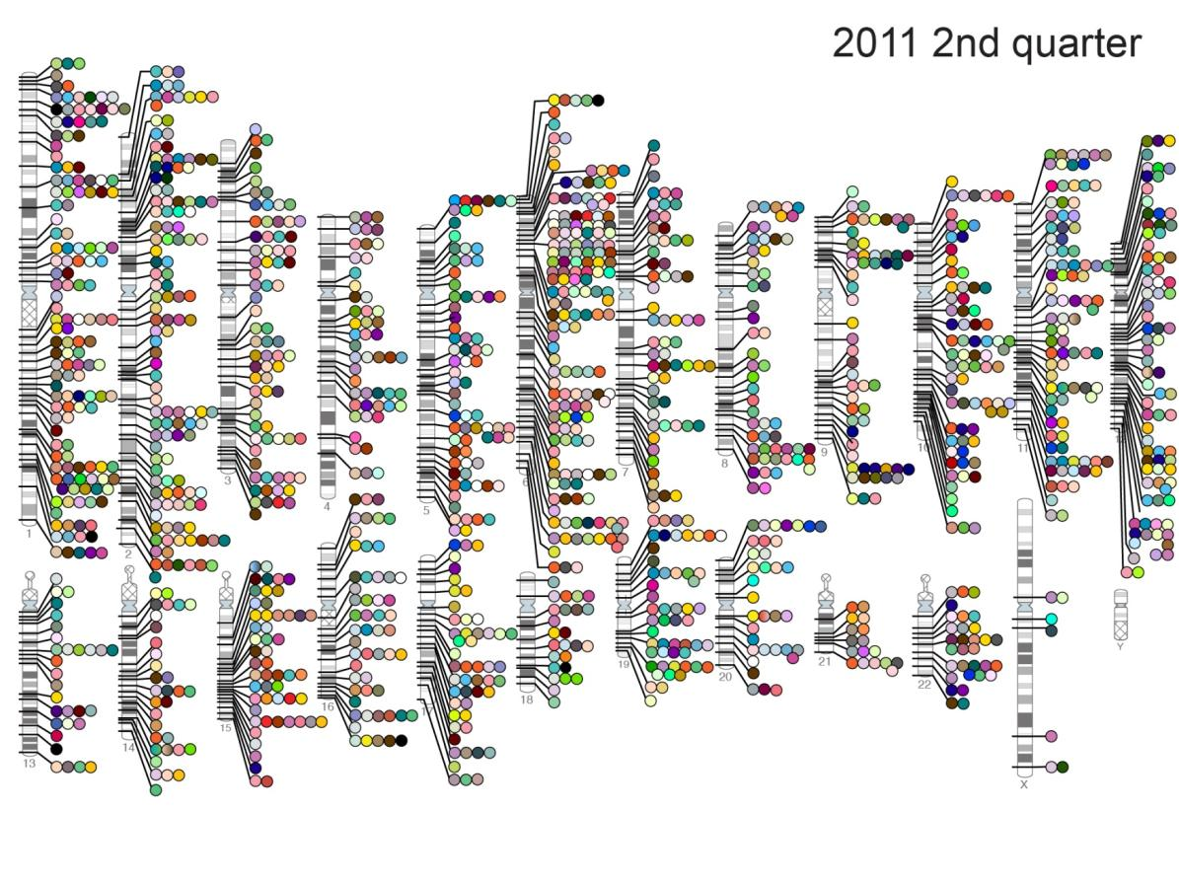
Published Genome-Wide Associations
By the time of the completion of the human genome sequence, in 2005, just a few genetic variants were known to be significantly associated to diseases.
When the first exhaustive catalogue of GWAS was compiled, in 2008, only three years later, more than 500 single nucleotide polymorphisms (SNPs) were associated to traits.
Today, the catalog has collected more than 1,900 papers reporting 14,012 SNPs significantly associated to more than 1,500 traits.
NHGRI GWA Catalog
www.genome.gov/GWAStudies

Slide 5
Lessons learned from GWAS
Many loci/variants contribute to complex-trait variation
There is evidence for pleiotropy, i.e., that the same loci/variants are associated with multiple traits.
Much of the heritability of the trait cannot be explained by the individual loci/variants found associated to the trait.
Visscher et al, 2013 AJHG

Slide 6

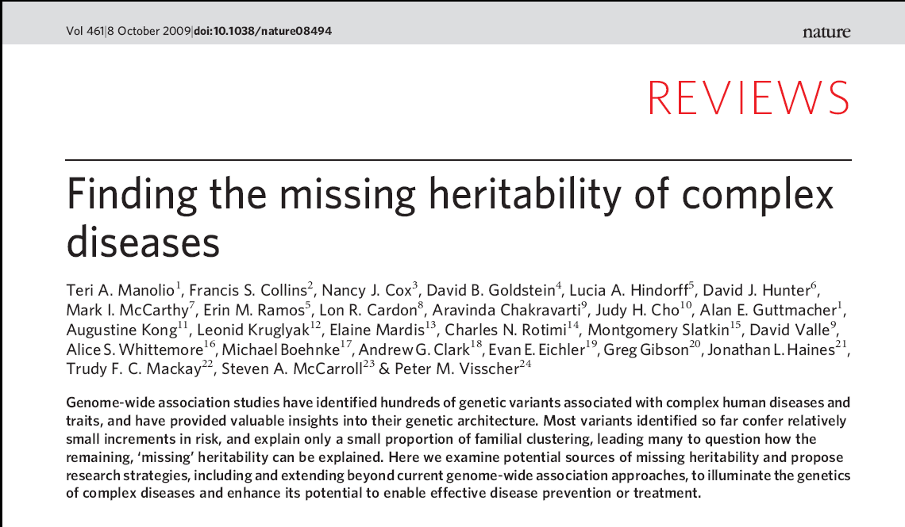
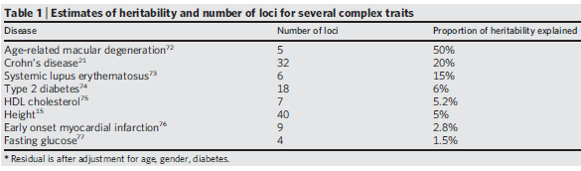
Where did the heritability go?
The missing heritability problem: individual genes cannot explain the heritability of traits
How to explain this problem?
Rare Variants, rare CNVs, epigenetics or.. epistatic effects?

Slide 7
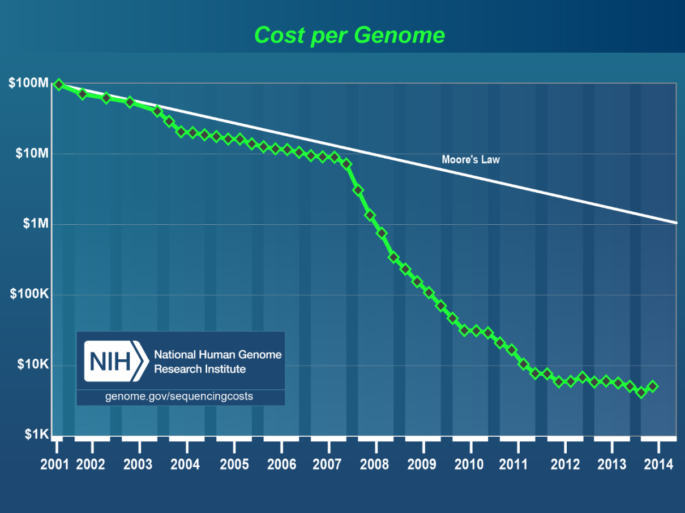
If rare variants eluded detection because were under represented among the SNPs, genomic sequencing would reveal them.
http://www.genome.gov/sequencingcosts/

Slide 8
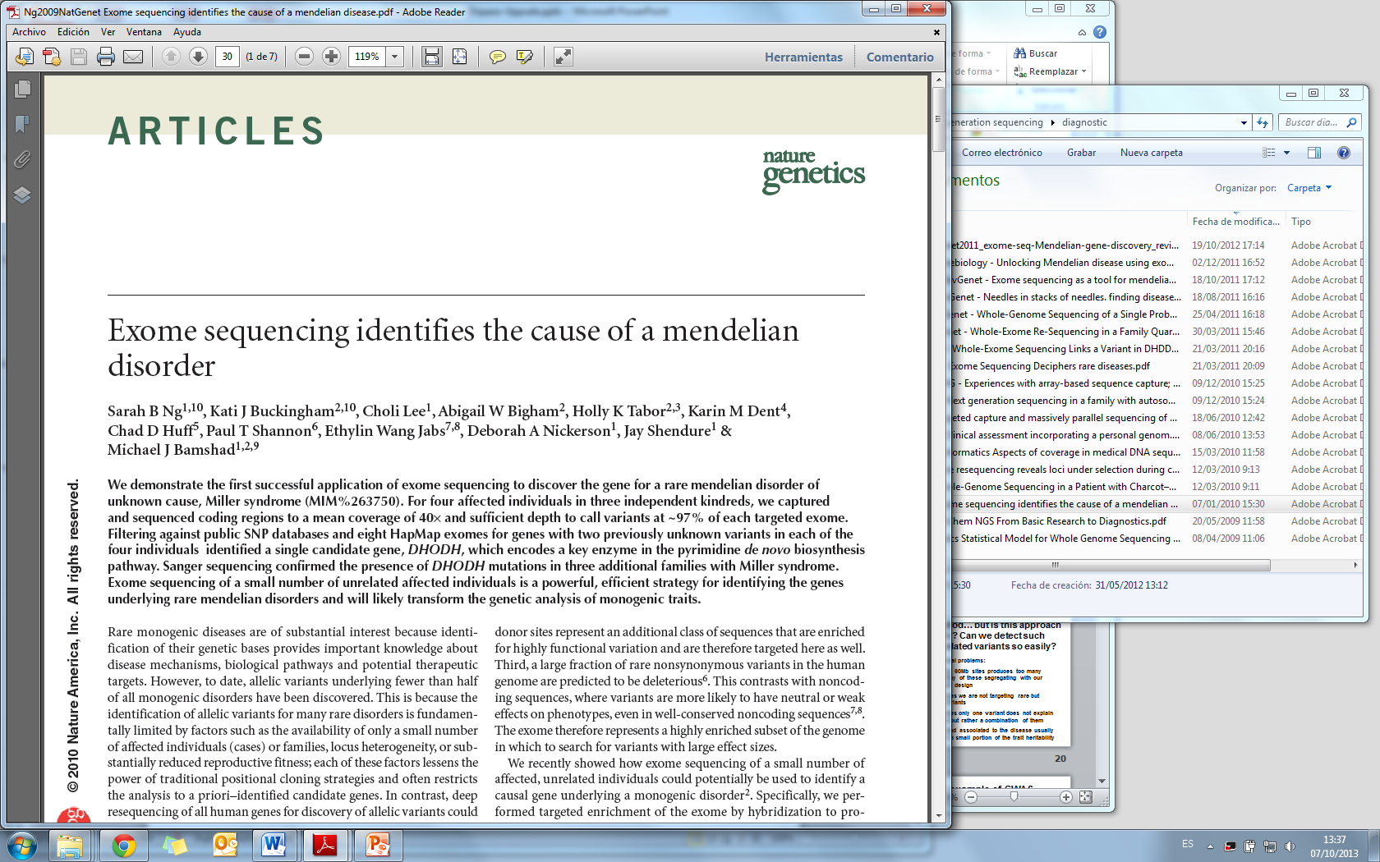
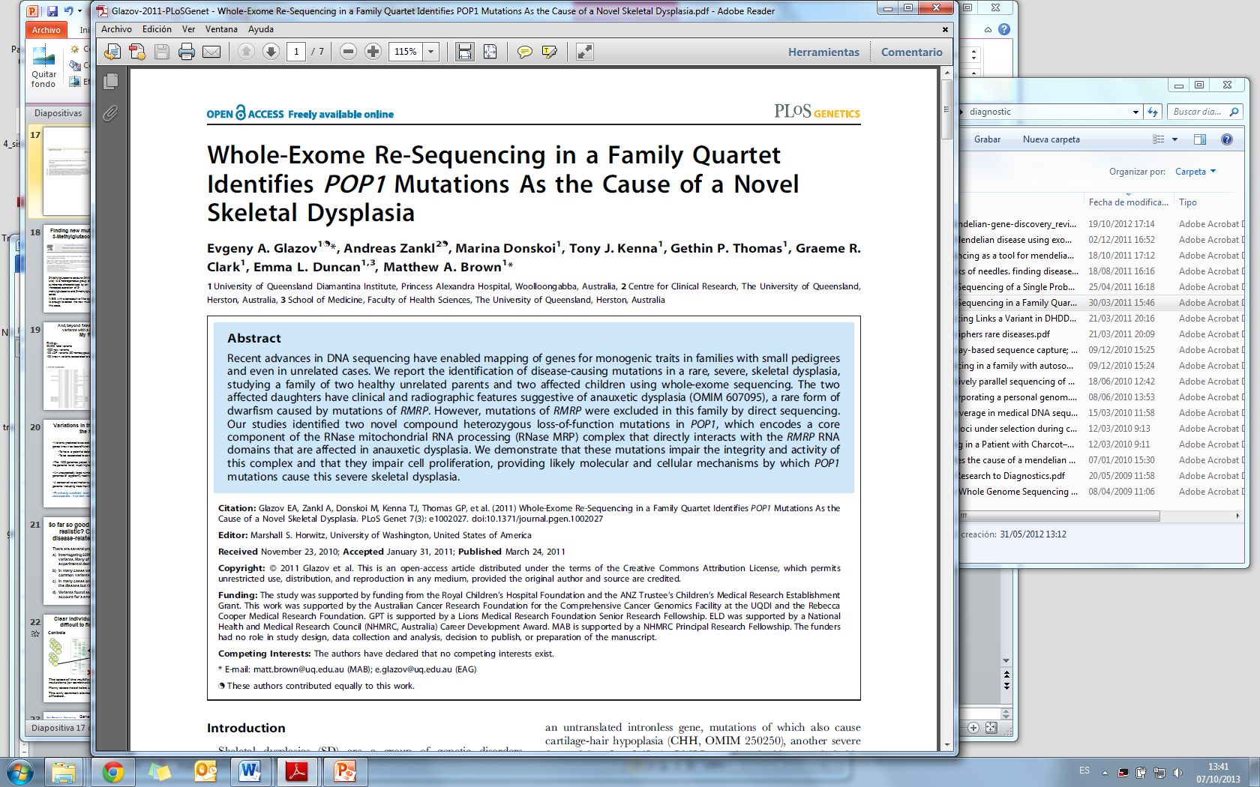
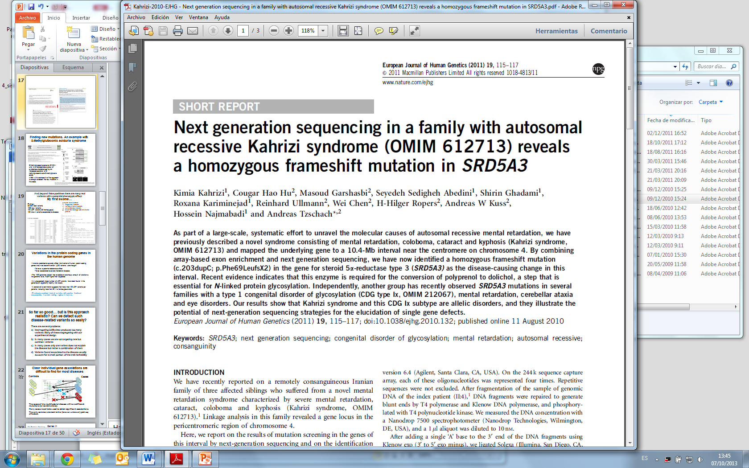
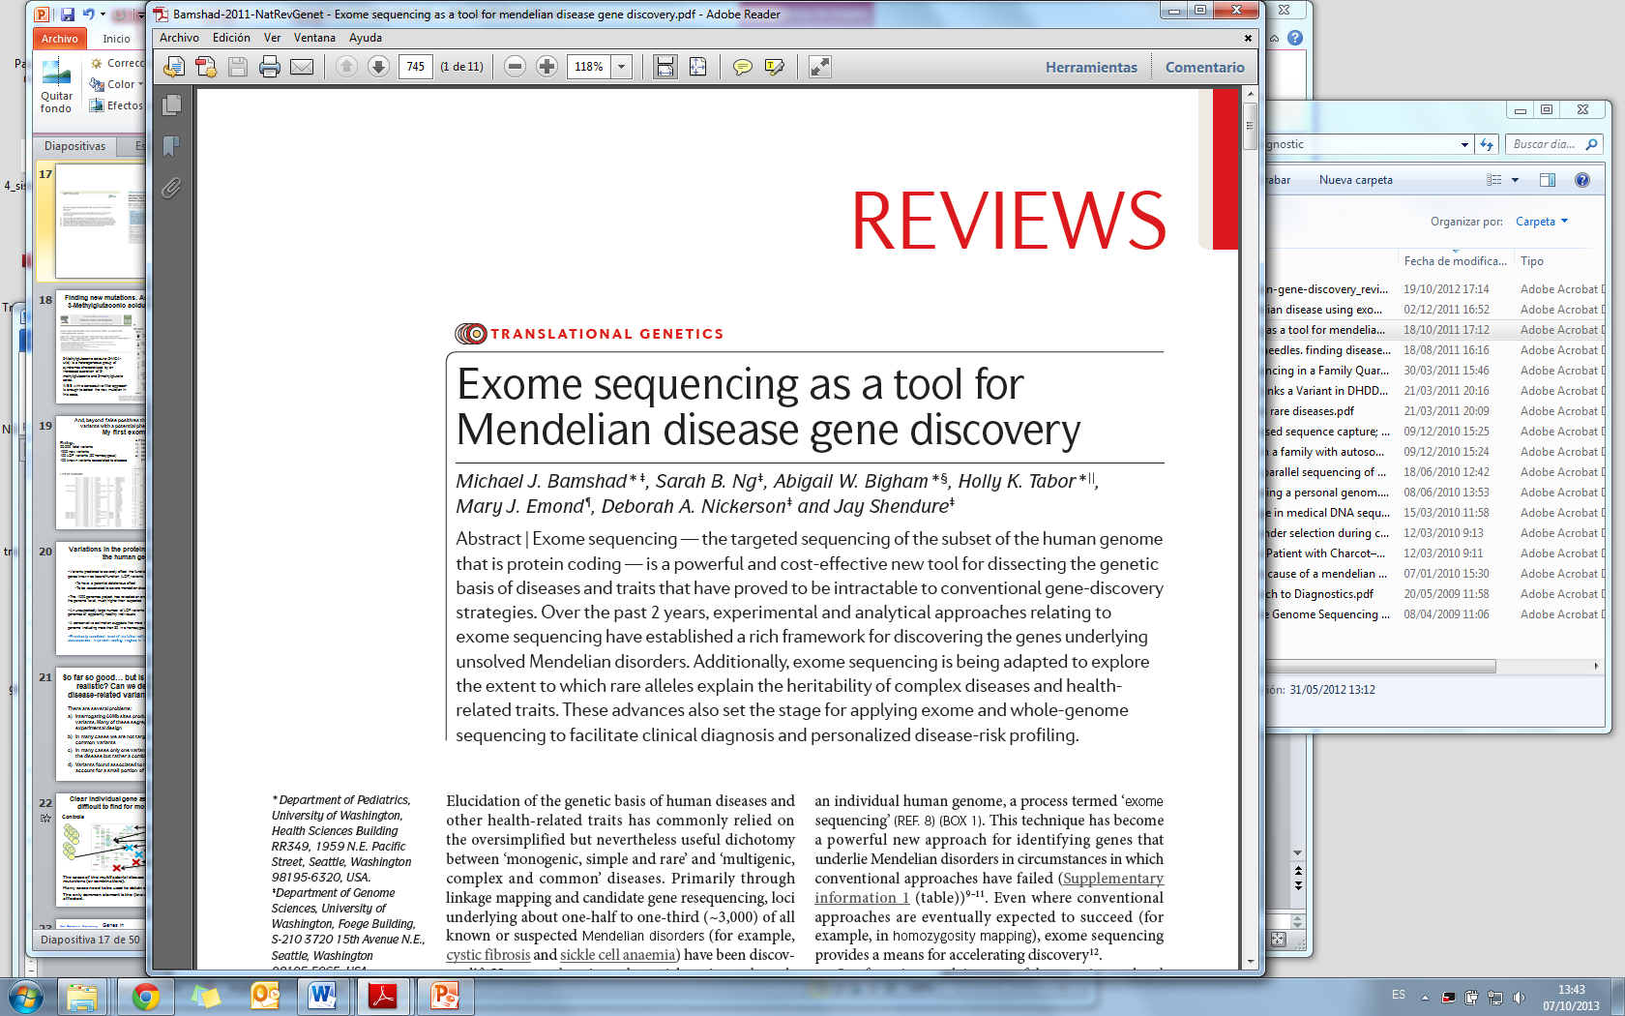
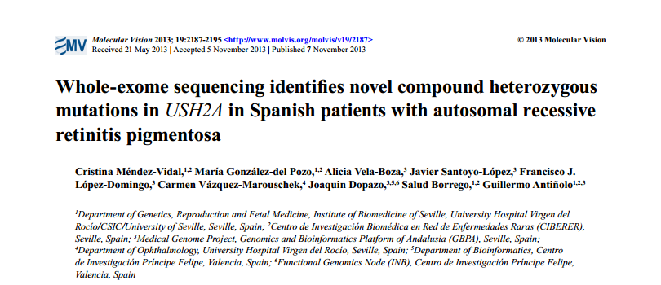
Exome sequencing has been systematically used to identify Mendelian disease genes

Slide 9
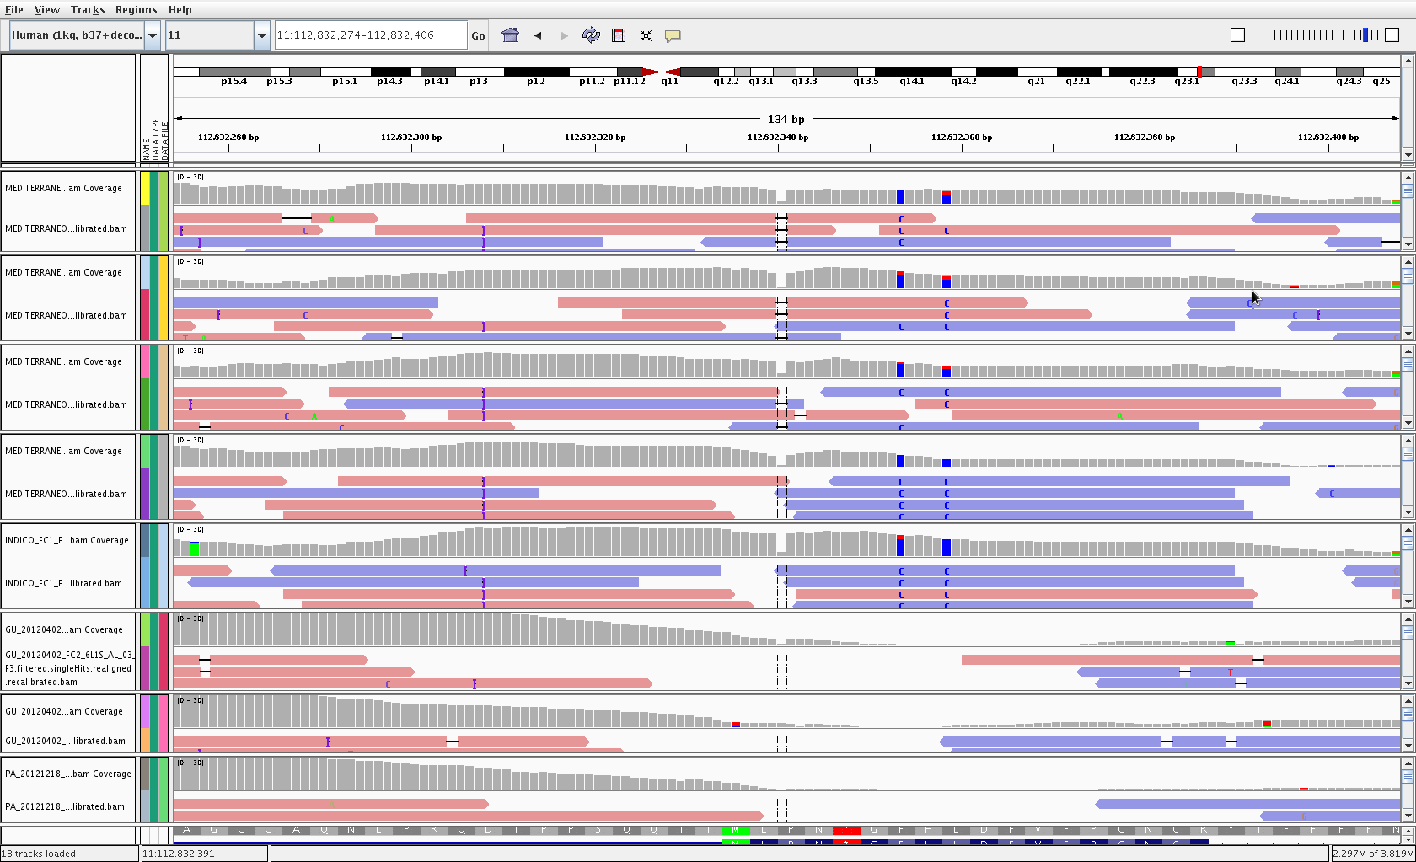
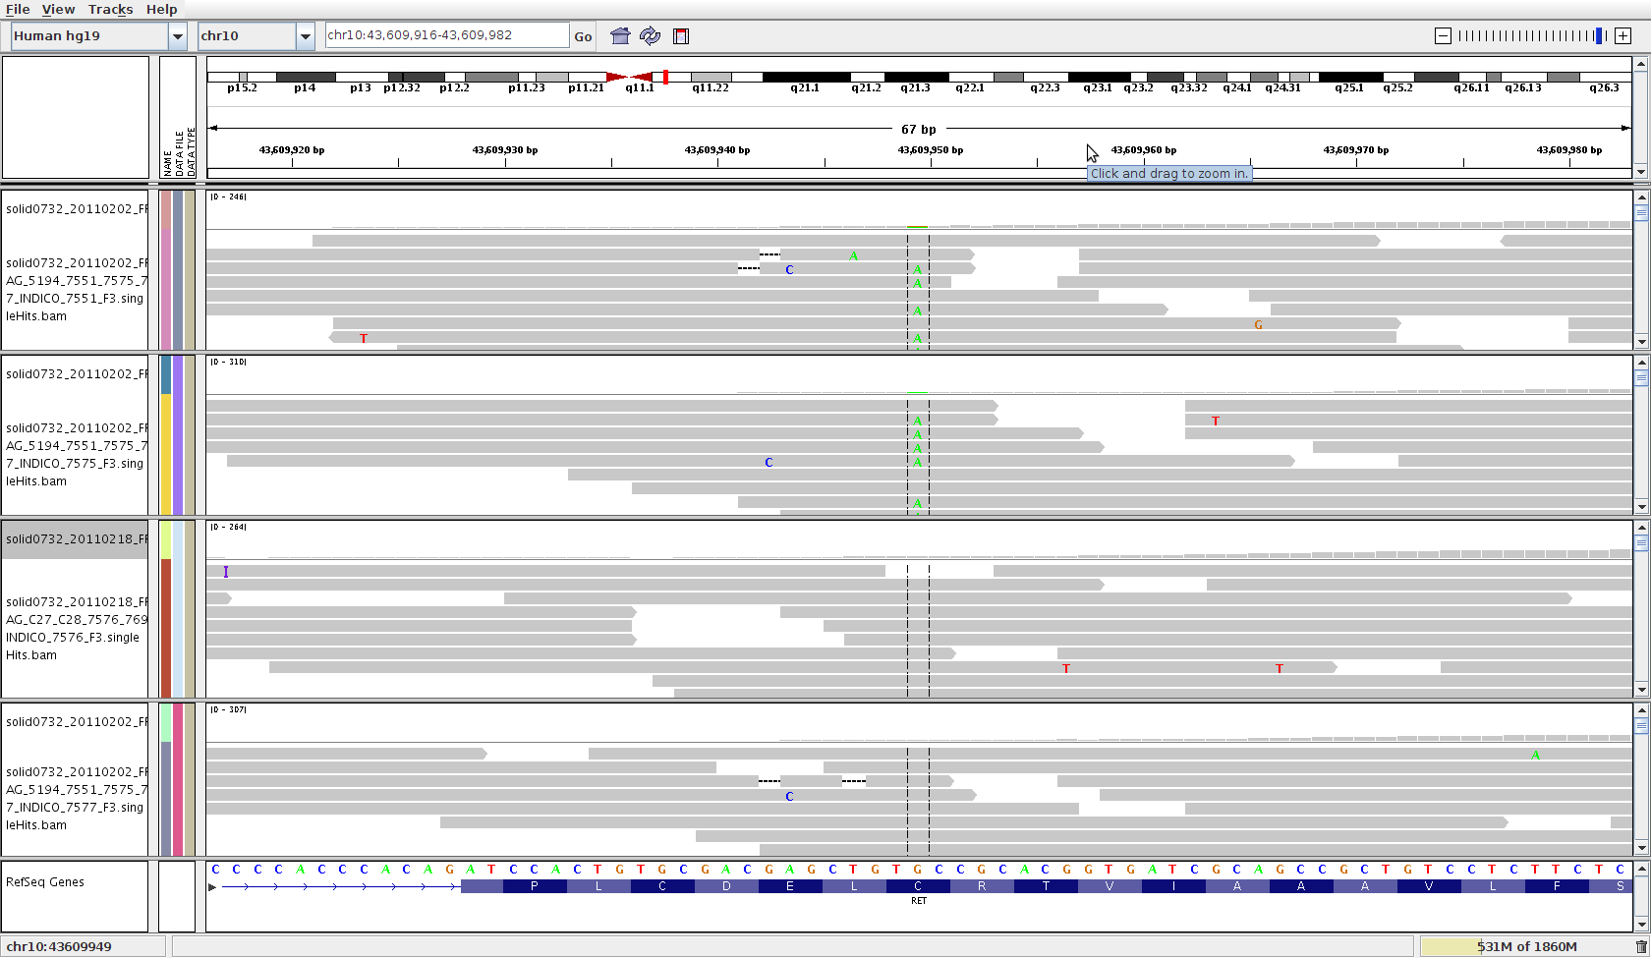
The principle: comparison of patients to reference controls or segregation within families
Cases
Controls
A
Segregation within a pedigree
A
B
D
B
D
C
C

Slide 10
Variant/gene prioritization by heuristic filtering
Variant level
Potential impact of the variant
Population frequencies
Experimental design level
Family(es)
Trios
Case / control
Functional (system) level
Gene set
Network analysis
Pathway analysis
Control of sequencing errors (missing values)
Testing strategies

Slide 11
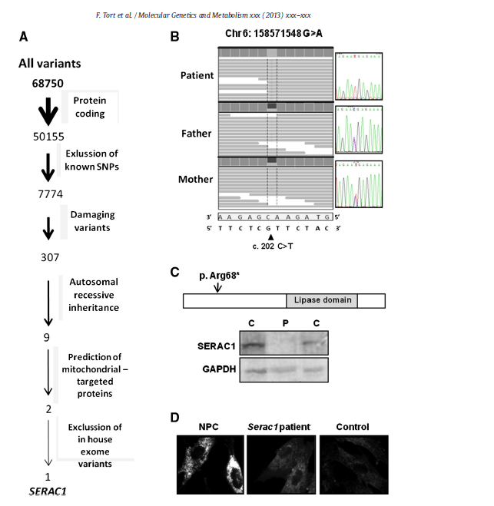
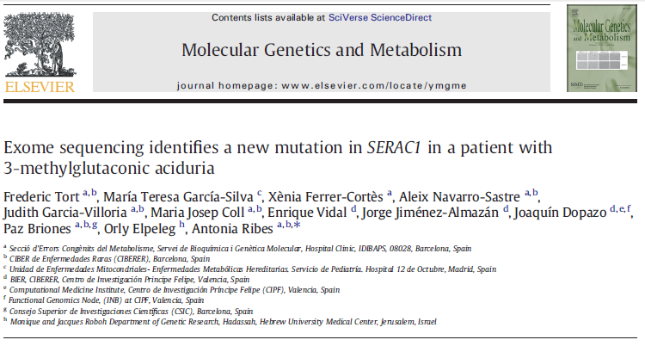
Heuristic Filtering approach An example with 3-Methylglutaconic aciduria syndrome
3-Methylglutaconic aciduria (3-MGA-uria) is a heterogeneous group of syndromes characterized by an increased excretion of 3-methylglutaconic and 3-methylglutaric acids.
WES with a consecutive filter approach is enough to detect the new mutation in this case.

Slide 12
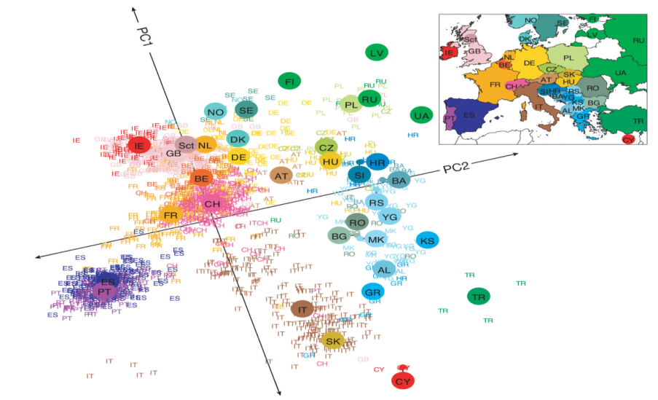
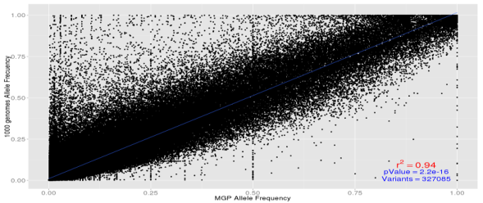
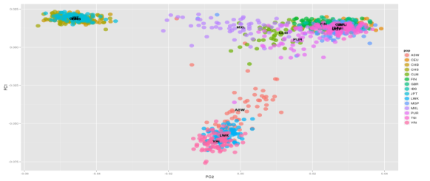
Use known variants and their population frequencies to filter out false candidates
How important do you think is local information to detect disease genes?
Typically dbSNP, 1000 genomes and the 6515 exomes from the ESP are used as sources of population frequencies.
We sequenced 300 healthy controls (rigorously phenotyped) to add and extra filtering step to the analysis pipeline
Novembre et al., 2008. Genes mirror geography within Europe. Nature
Comparison of MGP controls to 1000g

Slide 13
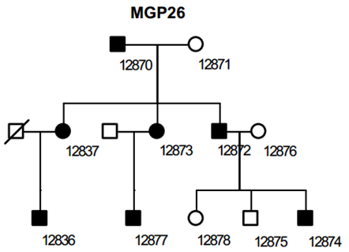
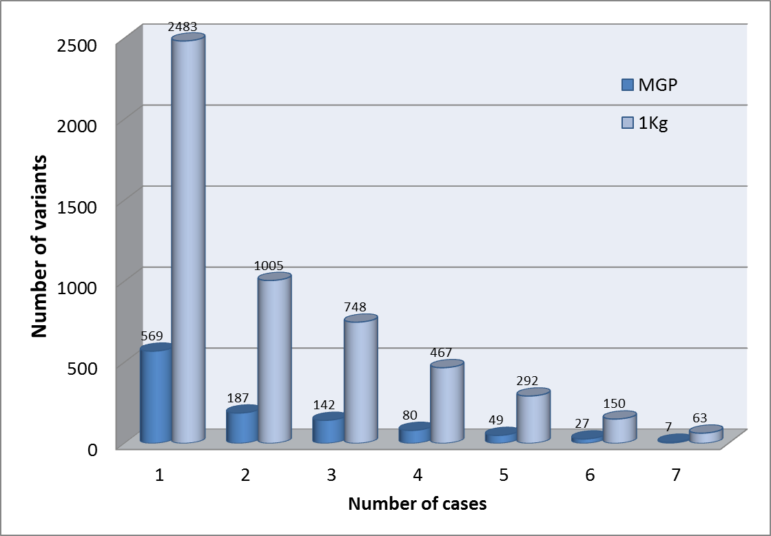
Filtering with or without local variants
Number of genes as a function of individuals in the study of a dominant disease Retinitis Pigmentosa autosomal dominant
The use of local variants makes an enormous difference

Slide 14
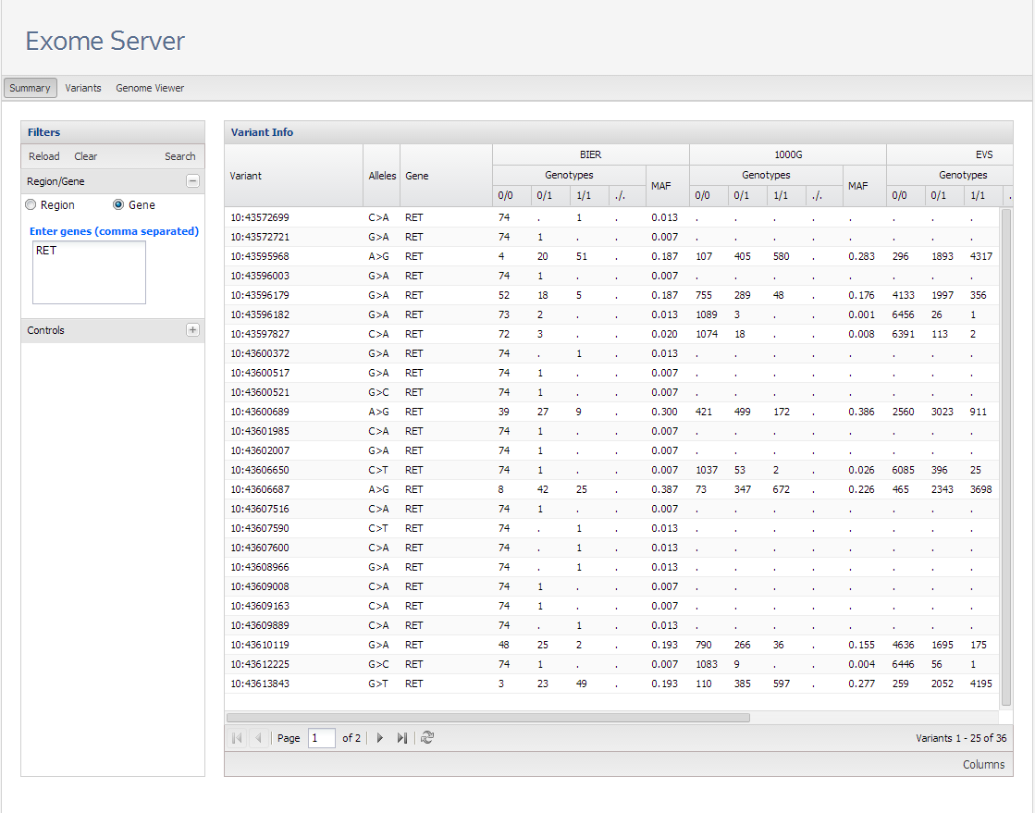
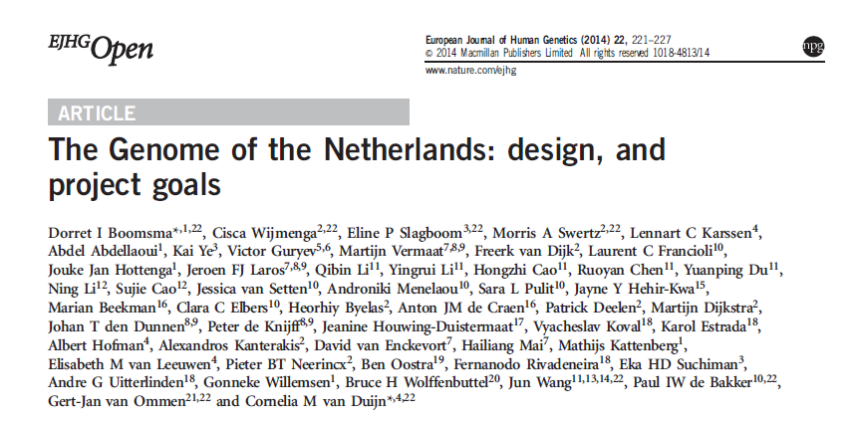
The CIBERER Exome Server (CES): the first repository of variability of the Spanish population
Used for more than one year and a half within CIBERER to discover new disease variants and genes.
Other similar initiatives arise. E.g. the GoNL http://www.nlgenome.nl/
http://ciberer.es/bier/exome-server/

Slide 15


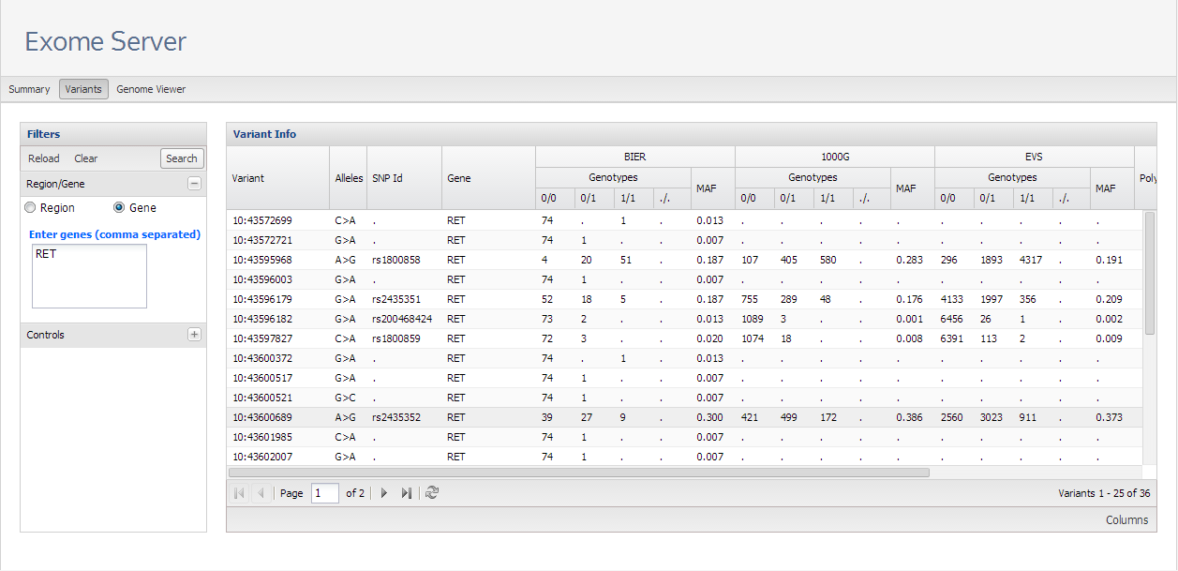
Information provided
Genomic coordinates, variation, and gene.
Genotypes in the different reference populations
SNPid if any

Slide 16
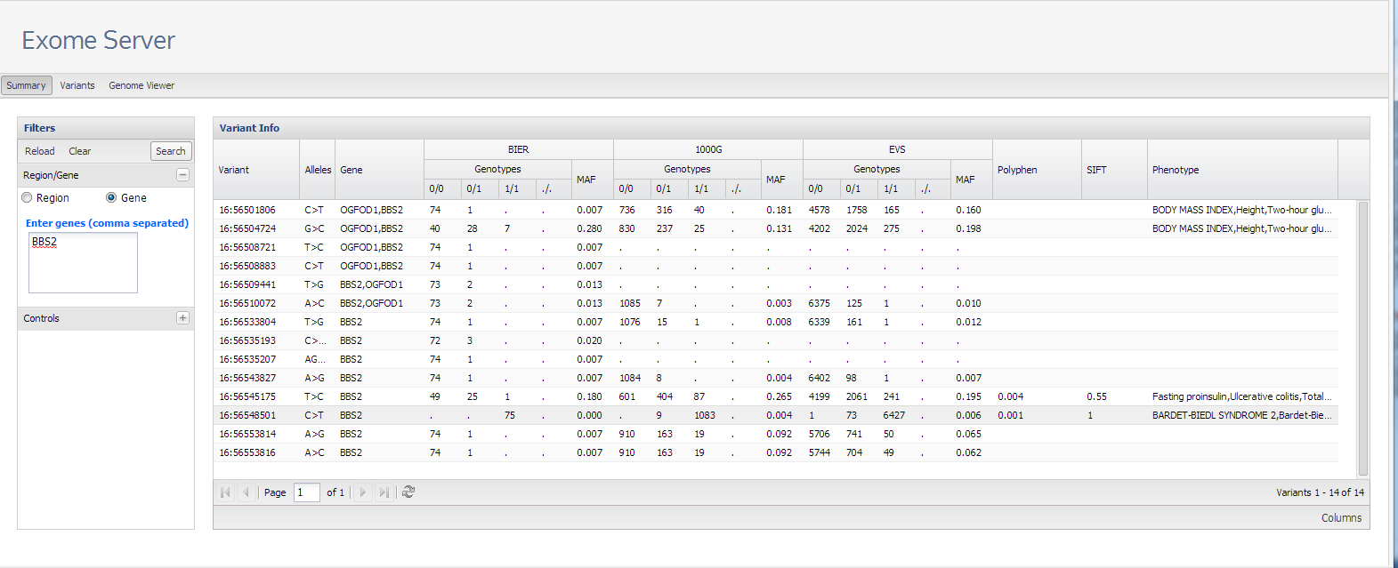
Occurrence of pathological variants in “normal” population
Reference genome is mutated
Nine carriers in 1000 genomes
One affected and 73 carriers in EVS

Slide 17
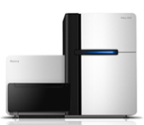
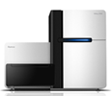
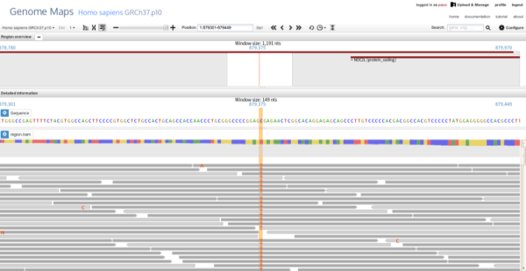

An example of end user’s tool BiERapp: interactive web-based tool for easy candidate prioritization by heuristic filtering
SEQUENCING CENTER
Data preprocessing
Genome Maps
BAM
FASTQ
VCF
Easy
scale up
No-SQL (Mongo) VCF indexing
BiERapp filters
Population frequencies
Consequence types
Experimental
design
BAM viewer and
Genomic context
?

Slide 18
How efficient is exome/genome sequencing? Low rate of false negatives. An example with MTC
Dominant:
Heterozygotic in A and D
Homozygotic reference allele in B and C
Homozygotic reference allele in controls
A
B
D
C
A
D
The codon 634 mutation
B
C

Slide 19
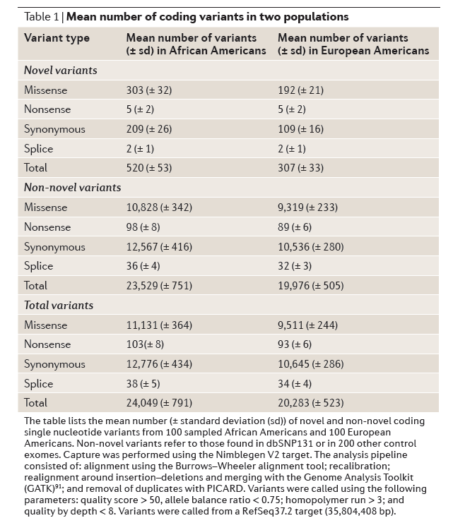
Heuristic filtering approach. Exome sequencing produces many false positives
Average values obtained per exome (>800)
After filtering by: | SNVs
Conventional filter QC, coverage… | 60,000
Mapping and haplotype coherence, missing sites… | 30,000
Nonsynonymous (nonsense and missense) | 5,000
Unknown (not present in controls) | 150-300
Segregate with the families | < 100
We can detect the disease mutation(s)… along with many other unrelated variants
Bamshad et al., 2011, Nat.Rev.Genet.

Slide 20
Some false positives are errors that can easily be avoided. E.g. missing positions
The promising variant (a frameshift present in all patients but not detected in controls) was nor real. It was not properly covered by reads in controls.

Slide 21
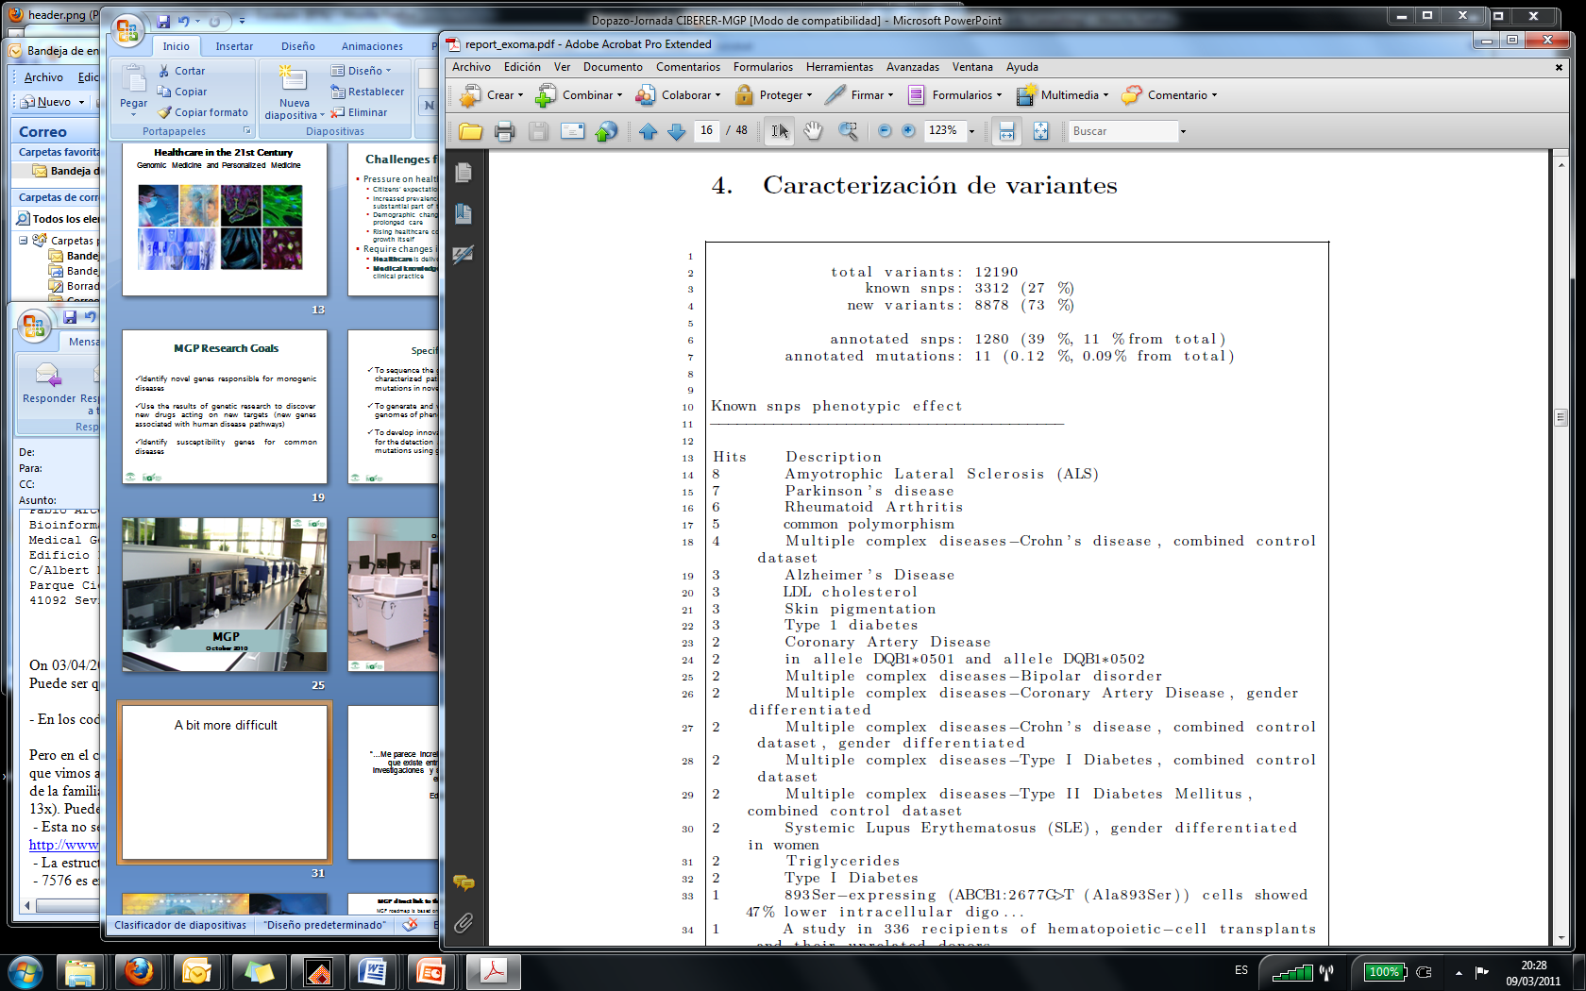
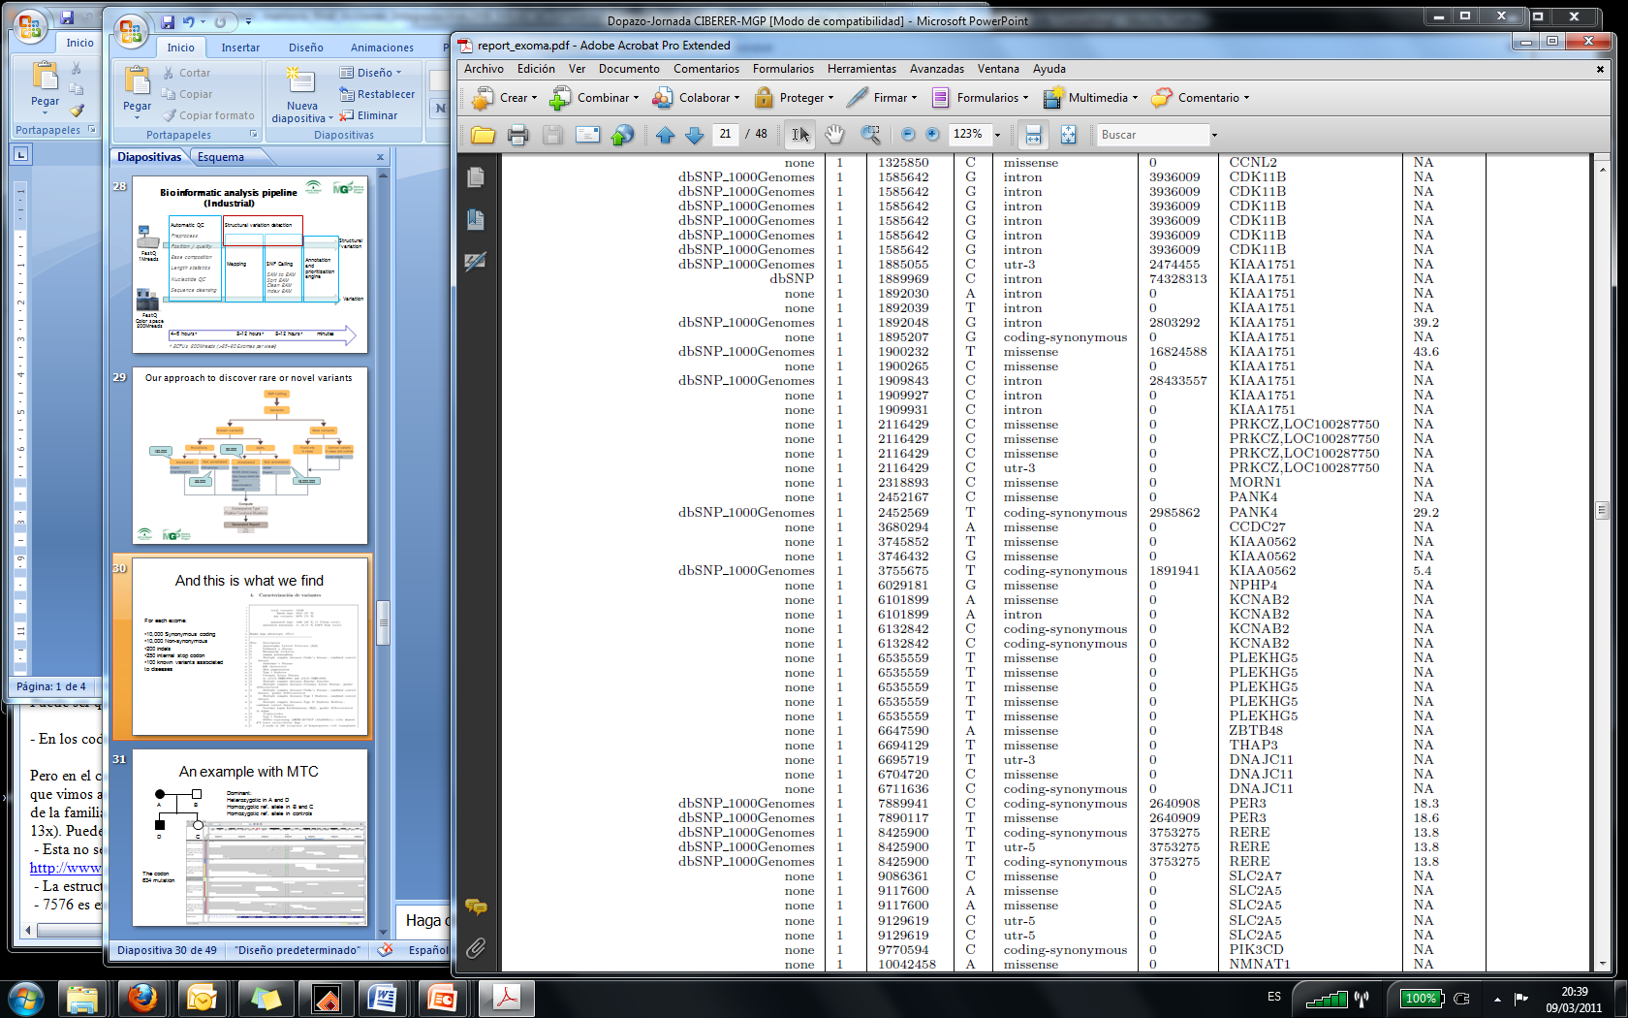
And there are many real variants with potential phenotypic effect
Findings:
20.000 total variants
1000 new variants
300-500 LOF variants (>50 homozygous)
100 known variants associated to disease
A report must contain:
Diagnostic variants
Therapy-related variants
Susceptibility variants
Incidental findings with risk for the patient
My first exome…
List of variants

Slide 22
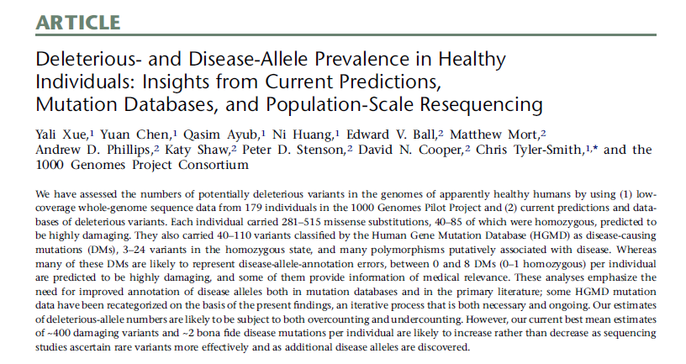
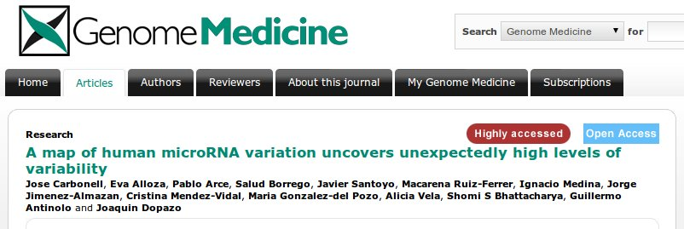
A high level of deleterious variability exists in the human genome
Variants predicted to severely affect the function of human protein coding genes known as loss-of-function (LOF) variants were thought:
To have a potential deleterious effect
To be associated to severe Mendelian disease
However, an unexpectedly large number of LOF variants have been found in the genomes of apparently healthy individuals: 281-515 missense substitutions per individual, 40-85 of them in homozygous state and predicted to be highly damaging.
A similar proportion was observed in miRNAs and possibly affect to any functional element in the genome
Such apparently deleterious mutation must be first detected and then distinguished from real pathological mutations

Slide 23
Moreover, even Mendelian genes can be elusive. Intuitive belief: multiple family information should help
 | Families
 | 1 | 2 | 3 | 4 | 5 | 6
Variants | 3403 | 82 | 4 | 0 | 0 | 0
Genes | 2560 | 331 | 35 | 8 | 1 | 0
Observation: this is not always true, not even in cases of Mendelian diseases

Slide 24
Is the single-gene approach realistic? Can we easily detect disease-related variants?
There are several problems:
Interrogating 60Mb sites (3000 Mb in genomes) produces too many variants. A large number of these segregating with our experimental design
There is a non-negligible amount of apparently deleterious variants that (apparently) has no pathologic effect
In many cases we are not targeting rare but common variants (which occur in normal population)
In many cases only one variant does not explain the disease but rather a combination of them (epistasis)
Consequently, the few individual variants found associated to the disease usually account for a small portion of the trait heritability

Slide 25
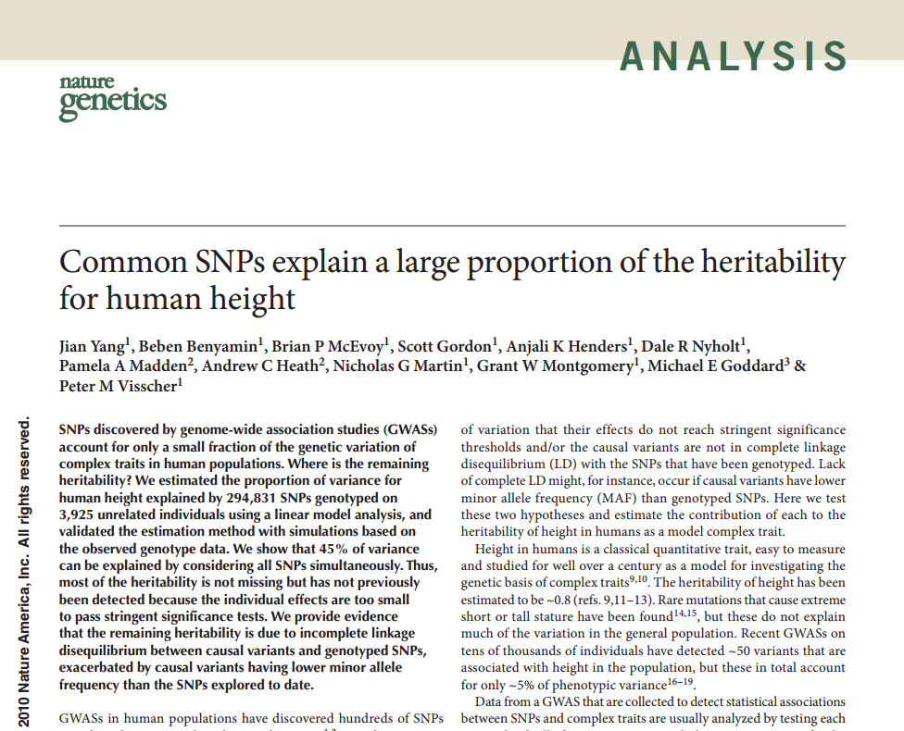
Is the heritability missing or are we looking at the wrong place?
How to explain missing heritability?
Rare Variants, rare CNVs, epigenetics or.. epistatic effects?
At the end, most of the heritability was there…

Slide 26
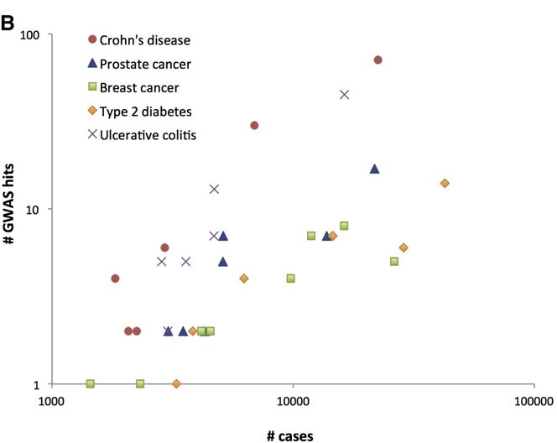
At the crossroad: how detection power of genomic technologies can be increased?
There are two (non mutually exclusive) ways
Scaling up: by increasing sample size.
It is known that larger size allows detecting more individual gene (biomarker) associations.
Limitations: Budget, patients availability and the own nature of the disease.
Changing the perspective: systems approach to understand variation
Interactions, multigenicity can be better detected and the role of variants understood in the context of disease mechanism.
Limitations: Available information

Slide 27
Modular nature of human genetic diseases
With the development of systems biology, studies have shown that phenotypically similar diseases are often caused by functionally related genes, being referred to as the modular nature of human genetic diseases (Oti and Brunner, 2007; Oti et al, 2008).
This modularity suggests that causative genes for the same or phenotypically similar diseases may generally reside in the same biological module, either a protein complex (Lage et al, 2007), a sub-network of protein interactions (Lim et al, 2006) , or a pathway (Wood et al, 2007)

Slide 28
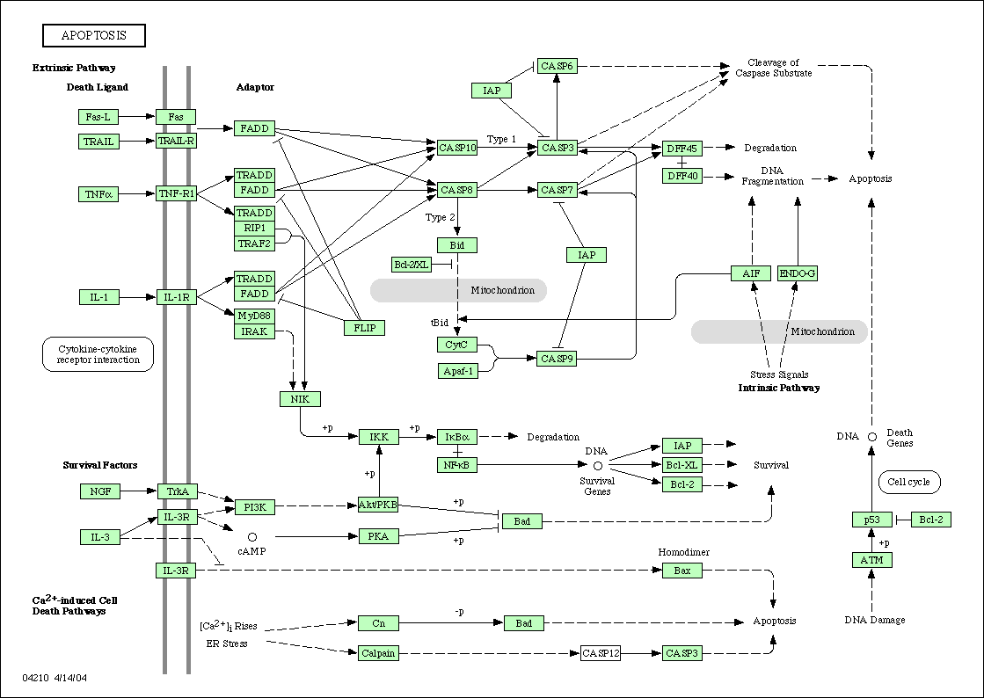
An approach inspired on systems biology can help in detecting causal genes
Controls
Cases
Affected cases in complex diseases will be a heterogeneous population with different mutations (or combinations).
Many cases and controls are needed to obtain significant associations.
The only common element is the (know or unknown) pathway affected.
Disease understood as the failure of a functional module

Slide 29
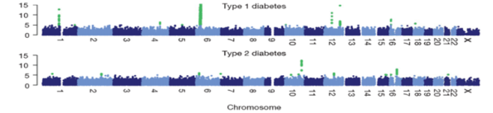
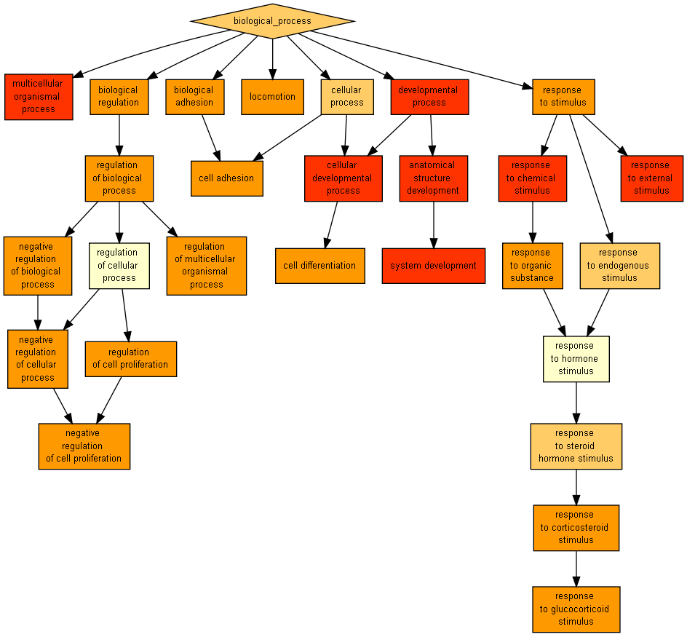

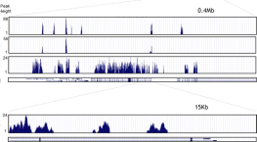
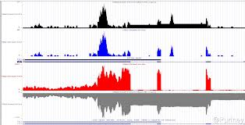
From gene-based to function-based perspective
SNPs
WES/WGS
Gene integrity
AND/OR
Gene activity
Gene Ontology
Gene expression
Gene Ontology are labels to genes that describe, by means of a controlled vocabulary (ontology), the functional role(s) played by the genes in the cell.
A set of genes sharing a GO annotation can be considered a functional module.

Slide 30
An example of GWAS
GWAS in Breast Cancer.
The CGEMS initiative. (Hunter et al. Nat Genet 2007)
1145 cases 1142 controls. Affy 500K
Conventional association test reports only 4 SNPs significantly mapping only on one gene: FGFR2
Conclusions: conventional SNP-based or gene-based tests are not providing much resolution.

Slide 31
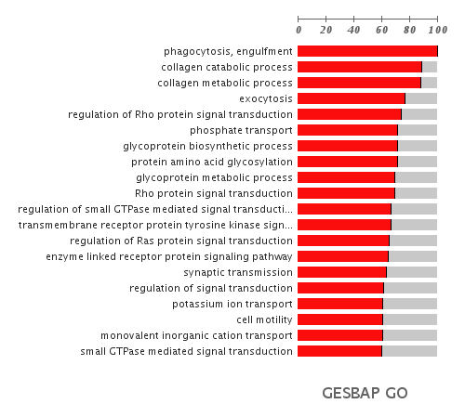
The same GWAS data re-analyzed using a function-based test
Breast Cancer
CGEMS initiative. (Hunter et al. Nat
Genet 2007)
1145 cases 1142 controls. Affy 500K
Only 4 SNPs were significantly associated, mapping only in one gene: FGFR2
PBA reveals 19 GO categories including regulation of signal transduction (FDR-adjusted p-value=4.45x10⁻⁰³) in which FGFR2 is included.
Bonifaci et al., BMC Medical Genomics 2008; Medina et al., 2009 NAR

Slide 32

GO processes significantly associated to breast cancer
Metastasis
Chromosomal instability
Rho pathway

Slide 33

From gene-based to function-based perspective
SNPs,
Gene expression
Gene₁
Gene₂
Gene₃
Gene₄
:
:
:
Gene₂₂₀₀₀
Gene Ontology
 | SNPs, gene exp. | GO
Detection power | Low (only very prevalent genes) | high
Annotations available | many | many
Use | Biomarker | Illustrative, give hints

Slide 34



Can the interactome help to find disease mutations?
Disease genes are close in the interactome
Goh 2007 PNAS
Cancer genes are central.
Hernandez, 2007 BMC Genomics
Deleterious mutations in 1000g (up) and somatic CLL deleterious mutations (down)
Garcia-Alonso 2014 Mol Syst Biol

Slide 35

The role of interactome in buffering the deleteriousness of LoF mutations
Comparison of the interactome damage between real and random individuals after removing the nodes corresponding to proteins containing deleterious variants in both alleles (homozygote). Two different scenarios are simulated: Simulated populations with uniform probability, where proteins are randomly removed, and Simulated populations with observed frequencies, where proteins are removed with a probability proportional to the frequency of variation in the 1000 genomes population
Garcia-Alonso 2014 Mol Syst Biol

Slide 36


From gene-based to function-based perspective
Using protein interaction networks as an scaffold to interpret the genomic data in a functionally-derived context
SNPs
WES/WGS
Gene integrity
AND/OR
Gene activity
What part of the interactome is active and/or is damaged
Gene expression

Slide 37




Network analysis helps to find disease genes in complex diseases
CHRNA7 (rs2175886 p = 0.000607)
IQGAP2 (rs950643 p = 0.0003585)
DLC1 (rs1454947 p = 0.007526)
SNPs validated in independent cohorts

Slide 38
From gene-based to function-based perspective
 | SNPs, gene expression, etc. | GO | Protein interaction networks
Detection power | Low (only very prevalent genes) | High | High
Information coverage | Almost all | Almost all | Less (~9000 genes in human)
Use | Biomarker | Illustrative, give hints | Biomarker*
*Need of extra information (e.g. GO) to provide functional insights in the findings

Slide 39
From gene-based to mechanism-based perspective
Transforming gene expression values into another value that accounts for a function. Easiest example of modeling function: signaling pathways. Function: transmission of a signal from a receptor to an effector
Receptor
Effector
Activations and repressions occur

Slide 40

The effects of changes in gene activity are not obvious
What would you predict about the consequences of gene activity changes in the apoptosis pathway in a case control experiment of colorectal cancer?
The figure shows the gene up-regulations (red) and down-regulations (blue)

Slide 41

Apoptosis inhibition is not obvious from gene expression
Two of the three possible sub-pathways leading to apoptosis are inhibited in colorectal cancer. Upper panel shows the inhibited sub-pathways in blue. Lower panel shows the actual gene up-regulations (red) and down-regulations (blue) that justify this change in the activity of the sub-pathways

Slide 42


Different pathways cross-talk to deregulate programmed death in Fanconi anemia
No proliferation
No degradation
No degradation
Survival
Activation apoptosis pathway
No
apoptosis
FA is a rare chromosome instability syndrome characterized by aplastic anemia and cancer and leukemia susceptibility. It has been proposed that disruption of the apoptotic control, a hallmark of FA, accounts for part of the phenotype of the disease.

Slide 43
From gene-based to function-based perspective
 | SNPs, gene expression, etc. | GO | Protein interaction networks | Models of cellular functions
Detection power | Low (only very prevalent genes) | High | High | Very high
Information coverage | Almost all | Almost all | Low (~9000 genes in human) | Low (~6700 genes in human)*
Use | Biomarker | Illustrative, give hints | Biomarker | Biomarker that explain disease mechanism
*Only ~800 genes in human signaling pathways

Slide 44


Future prospects Known causes of Human Genetic Diseases
Hospital Universitario La Paz
Pablo Lapunzina, Personal communication
5 Kb- ? Mb
1 bp- 200 bp
No dosage changes
GENOMICS
GENETICS
EPIGENETICS
All genetic/genomic
or epigenetic
diseases with known
cause:
~ 5000 disorders
8-12%
82-87%
2-3%
Unknown or No- responsible genes
Fact: exons represent a comparatively small part of the complete genome
Other fact: there is still a lot of missing heritability

Slide 45

The ENCODE project suggests a functional role for a large fraction of the genome
Which percentage of the genome is occupied by:
Coding genes: 2.4%
TFBSs 8.1%
Open chromatin regions 15.2%
Different RNA types 62.0%
Total annotated elements: 80.4%
Exomes are only covering a small fraction of the potential functionality of the genome (2.4%).
Is the missing heritability hidden in the remaining 78%?
If so, what type of variant should be expect to discover? SNVs? SVs?

Slide 46

Future prospects
We need to efficiently query all the information contained in the genome, including all the epigenomic signatures.
This means data integration and “epistatic” queries
We need to prepare our health systems to deal with all the genomic data flood
Information about variations Processed Raw
Genome variant information (VCF) 150 MB 250 GB
Epigenome 150 MB 250 GB
Each transcriptome 20 MB 80 GB
Individual complete variability 400 MB 525 GB
Hospital (100.000 patients) 40 TB 50 PB
There are technical problems and conceptual problems on how genomic information is managed that must be addressed in the near future.

Slide 47











Software development
Functional analysis
Mapping
HPC on CPU, SSE4, GPUs on NGS data processing
Speedups up to 40X
Visualization
Ultrafast genome viewer with google technology
Babelomics is the third most cited tool for functional analysis. Includes more than 30 tools for advanced, systems-biology based data analysis
See interactive map of for the last 24h use http://bioinfo.cipf.es/toolsusage
Variant prioritization
Diagnostic
Genome maps is now part of the ICGC data portal
NGS panels
Variant annotation
Signaling network
Regulatory network
Interaction network
CellBase
Knowledge database
More than 150.000 experiments were analyzed in our tools during the last year

